Slide 1
Refactoring
Improving code

Slide 2
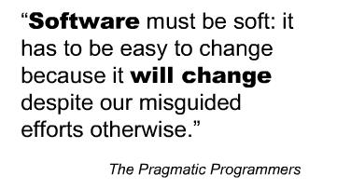


Slide 3

What is it?
Change the implementation
Preserve the external functionality
public class AveragingCalculator : IAggregateCalculation
{
public Measurement Aggregate(IEnumerable<Measurement> measurements)
{
return new Measurement()
{
HighValue = measurements.Average(m => m.HighValue),
LowValue = measurements.Average(m => m.LowValue)
};
}
}

Slide 4
The Mantra
Red
Green
Refactor

Slide 5
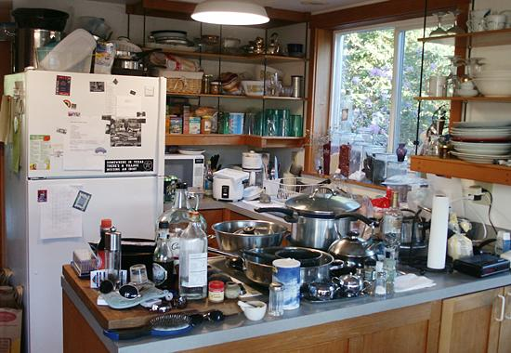
When Are You Done?

Slide 6

Why Refactor?
To improve the an “ility” of code
Readability
Maintainability
Even scalability, extensibility
Deadlines
Your Code
Bug Fixes
Change Requests
New Features
Technical Debt

Slide 7
When To Refactor?
public class AveragingCalculator : IAggregateCalculation
{
public Measurement Aggregate(IEnumerable<Measurement> measurements)
{
return new Measurement()
{
HighValue = measurements.Average(m => m.HighValue),
LowValue = measurements.Average(m => m.LowValue)
};
}
}
public class AveragingCalculator : IAggregateCalculation
{
public Measurement Aggregate(IEnumerable<Measurement> measurements)
{
return new Measurement()
{
HighValue = measurements.Average(m => m.HighValue),
LowValue = measurements.Average(m => m.LowValue)
};
}
}
public class AveragingCalculator : IAggregateCalculation
{
public Measurement Aggregate(IEnumerable<Measurement> measurements)
{
return new Measurement()
{
HighValue = measurements.Average(m => m.HighValue),
LowValue = measurements.Average(m => m.LowValue)
};
}
}
public class AveragingCalculator : IAggregateCalculation
{
public Measurement Aggregate(IEnumerable<Measurement> measurements)
{
return new Measurement()
{
HighValue = measurements.Average(m => m.HighValue),
LowValue = measurements.Average(m => m.LowValue)
};
}
}
public class AveragingCalculator : IAggregateCalculation
{
public Measurement Aggregate(IEnumerable<Measurement> measurements)
{
return new Measurement()
{
HighValue = measurements.Average(m => m.HighValue),
LowValue = measurements.Average(m => m.LowValue)
};
}
}
Complex If/Else
After fixing a failing test (red-green-refactor)
Before adding a new feature
After identifying a quality problem
Large class
Duplicated Code

Slide 8

When NOT to Refactor?
When you don’t have tests!
public class AveragingCalculator : IAggregateCalculation
{
public Measurement Aggregate(IEnumerable<Measurement> measurements)
{
return new Measurement()
{
HighValue = measurements.Average(m => m.HighValue),
LowValue = measurements.Average(m => m.LowValue)
};
}
}

Slide 9
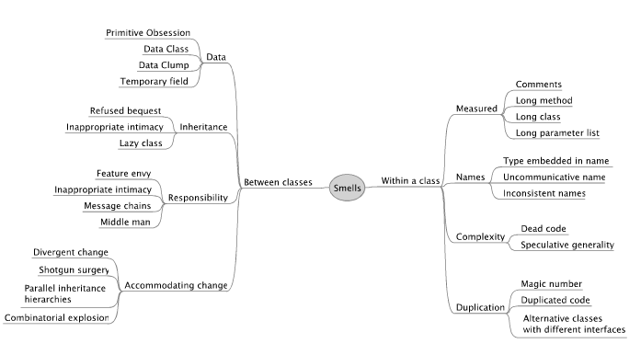
Code Smells (Fowler Refactoring)

Slide 10
Common Refeactorings
Extract method
Rename
Introduce parameter

Slide 11
Refactoring To Abstractions
Extract interface
Extract superclass

Slide 12
Refactoring To Design Patterns
Test have a knack of finding the flaws in an API
Decorator
Command
Strategy
Builder
Façade

Slide 13
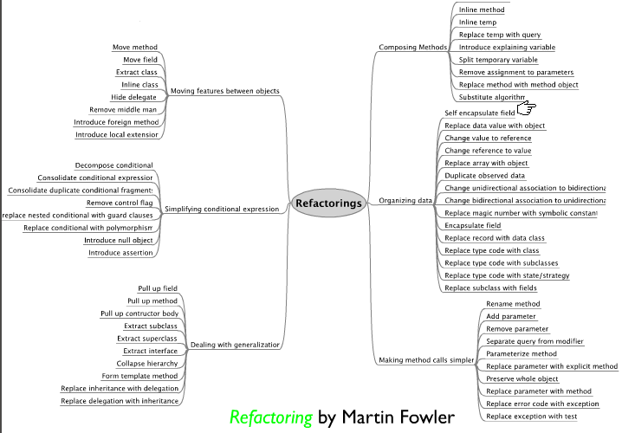

Slide 14
The Synergy Between Testability and Design
Test can tell you about design problems
Iceberg classes
State hidden in methods
Difficult setup
State leaks across tests
Environmental dependencies
Framework frustration
Difficult mocking
Hidden effects
Test thrash

Slide 15

Summary

